Slide 1
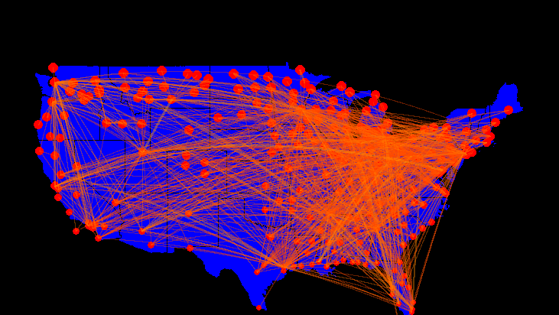
Scalable Algorithms for Updating Large-Scale Dynamic Networks
Presented by: Sriram Srinivasan
sriramsrinivas@unomaha.edu
github.com/SriramSrinivas/SriramDissertation

Slide 2
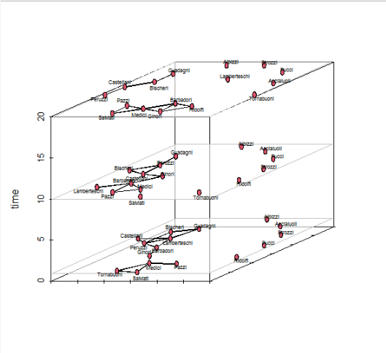
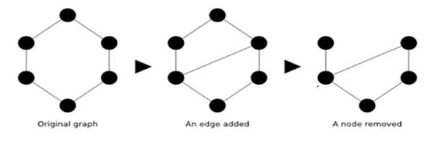
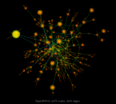
Dynamic Networks
Analyzing properties of the networks can help in understanding the characteristics of the underlying systems
High centrality vertices indicate in important proteins in PPI networks
Networks can evolve with time, so the properties of the dynamic networks should be updated
Goal: Update only the part of the network affected by the change, rather than recomputing from scratch
Dynamic, Unstructured Graphs

Slide 3
Related Work
Very few efforts on parallel update of dynamic networks (not weighted)
STINGER (Bader et. al.)
http://www.stingergraph.com/
Uses multithreaded architecture
Connected components, clustering coefficient, and page rank
PHISH (Plimpton and Shead)
http://www.sandia.gov/~sjplimp/phish.html
Map Reduce
Connected components, and sub-graph isomorphism

Slide 4
Overview of Presentation
NETWORK PROPERTIES
Dissertation/
Research
EXPERIMENTS/RESULTS
(Scalability, Comparison)
ALGORITHMS & ARCHITECTURE
(updating changes in HPC systems)
OBSERVATIONS
(Research Findings and Correctness/Proofs)

Slide 5
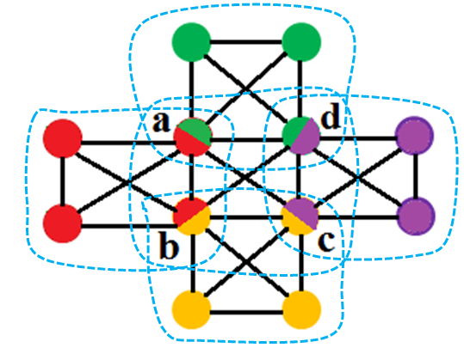
NETWORK PROPERTIES

Slide 6
Graph Connectivity
0
4
0
4
1
3
5
7
1
3
5
7
2
2
6
6
Connected Path
Original Network
0-4,3-5
Sparsification Tree
Edges in connected paths are in white (Key Edges)
Other edges are in black (Other Edges)
(0,1,3,4,5,6,7) (2)
1-3
5-6,4-7
4-6, 5-7
(0,1,3) (2) (4,5,6,7)
0-1
(0,1) (2) (3) (4,5) (6,7)
4-5
6-7
Notes:
We will now show how sparsification tree is used to check whether a dynamic network remains connected, and also to maintain one connected path.
On the left hand is our original network. On the right side is a path between the connected components. Node 2 is isolated. We now classify the edges in the sparsification tree based on whether the edges are in the connected paths or not. Edges in the path are called key edges and are marked in white. The remainder of the edges are in black and called Other edges. At each level, the numbers in the parenthesis show the nodes that are in the same component.

Slide 7
Edge Insertion
0
4
0
4
1
3
5
7
1
3
5
7
Insert (3,2): different components: mark as insert
Insert (3,6): same component: add to the set of other edges
Insert (0,2): different components: mark as insert
2
6
2
6
Connected Path
0-4,3-5
3-6
1-3
0-2
5-6,4-7
4-6, 5-7
0-1
2-3
4-5
6-7
Number of Threads

Slide 8
Edge Deletion
0
4
0
4
1
3
5
7
1
3
5
7
2
2
6
6
Original Network
Connected Path
Delete (3,5): Key Edge : mark as delete
Delete (4,6): Other edge: delete it
Limitations
Not Scalable for MST
0-4,3-5
3-6
1-3
0-2
5-6,4-7
4-6, 5-7
0-1
2-3
4-5
6-7
Application of Graph Sparsification in Developing Parallel Algorithms for Updating Dynamic Networks. S. Srinivasan, S. Das, S. Bhowmick, Graph Algorithms Building Blocks (GABB’2016)
Number of Threads

Slide 9
Graph Properties
Single Source Shortest Path (SSSP)
A
A
1
SSSP
1
4
2
2
B
C
2
B
C
2
2
F
2
2
F
1
1
D
E
2
D
E
Strongly Connected Components (SCC)
13
Minimum Weighted Spanning Tree (MST)
1
13
1
12
12
A
5
5
14
2
14
2
1
2
B
C
MST
4
11
4
10
11
3
10
2
3
F
9
6
9
6
1
2
D
E
8
7
8
7

Slide 10
Related Work
Network Property | Static Network | Dynamic Networks
SCC | Slota et al. Ji et al. (I-Span) Hong et al. ( extension of FW-BW) Li et al. (GPU) | None
PageRank | Page et al. Galois | Desikan et al.
SSSP | Gunrock Galois (Shared Memory) Havoqgt (Distributed Memory) | Rehman et al. (GPU) Ingole et al. (GPU) Ramalingam et al. Narvez at al. Bauer et al.
MST | Shiloach-Vishkin Boruvka | None

Slide 11
Template for Parallel Algorithm
Sparsification
Compute only over the edges that affect the property (Key Edges)
Remaining edges accessed for deletion only
Preprocessing before input of changes
Selection
Identify the added/deleted edges that affect the property
Can be done in parallel for each edge
Edges are not yet added or deleted from the MST
Updating
Update set of key edges according to the changes
Parallel over the edges, but requires multiple iterations
Non-key edges may need to be processed

Slide 12
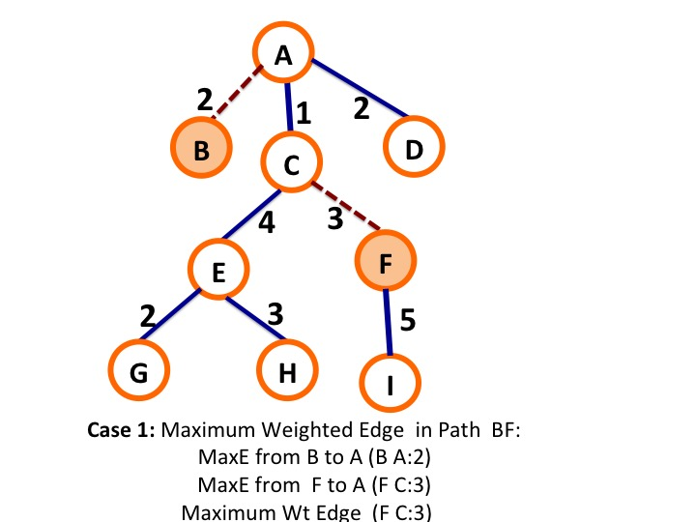
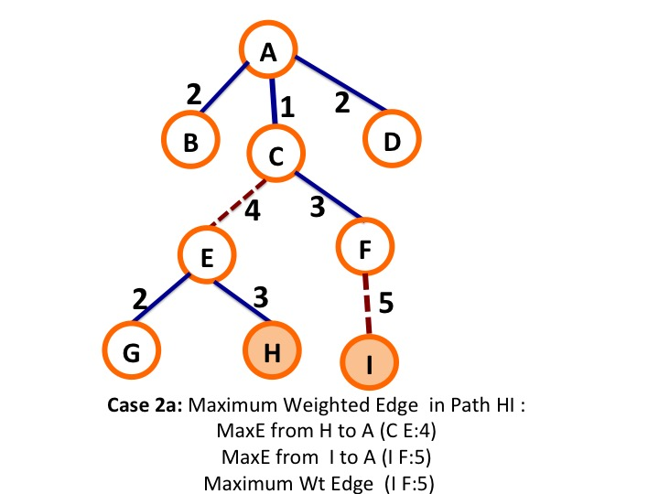
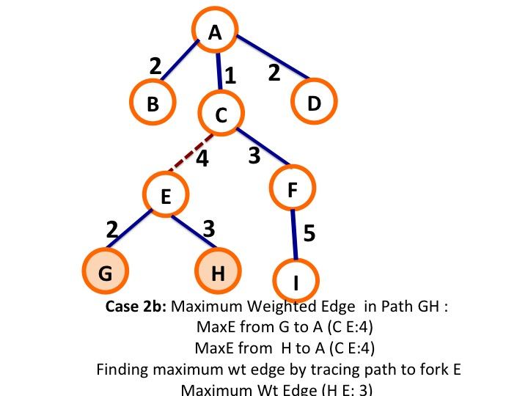
PARALLEL DYNAMIC GRAPH ALGORITHMS

Slide 13
Updating Minimum Spanning Tree
Original Network
Sparsification
A
A
1
4
1
Change Set
A:F:1 (Ins)
A:D:4 (Ins)
D:E:1 (Del)
A:C:4 (Del)
2
2
B
B
C
C
2
2
2
F
2
F
1
1
2
2
D
E
D
E
Selection
Updating
A
A
1
4
1
1
1
4
2
B
C
2
2
B
C
2
2
F
2
2
F
1
2
D
E
D
E

Slide 14
Issues with Insertion
An edge A-B is inserted if there is an edge in path from A to B in the MST that had higher weight
Finding the path between (u,v) for insertion—worst case complexity O(V+E). Can occur for each insertion
Complexity of simply re-doing the MST O(ELogV)
Solution: Store the maximum weighted edges between vertex pairs.
Storage O(V) ; Time O(V+E)
D
Root D
D:B (D-B)3
D:C (D-B) 3
D:A (D-B) 3
D:E (D-E) 2
D:F (E-F) 4
2
3
E
B
1
2
4
F
A
C

Slide 15
Issues with Deletion
Deletion can be done in parallel by simply marking the edge as deleted
Need to reassign component id of disconnected trees to recombine them
Solution: Mark deleted edges with very high weight (INF)
Apply insertion of remaining edges—reduces to insertion problem
Keep remainder edges in buckets of increasing weight
Once tree is reconnected stop
D
2
INF
E
B
1
2
4
F
A
C

Slide 16
Updating Single Source Shortest Path
Sparsification:
Store edges in the SSSP Tree. Done during initial computation. Rooted at source S
Selection:
Insertion: An edge u-v is inserted in
if dist (S,v) > dist(S,u)+ weight(u,v)
Reassign parent to insert edge
Deletion: An edge u-v is deleted if the edge is present in SSSP tree
Similar to MST, mark deleted edges with very high value to indicate it is deleted
Original Network
Sparsification
A
A
1
4
1
2
2
B
C
2
B
C
2
2
2
F
2
F
1
2
1
D
E
D
E
Change Set
A:F:1 (Ins)
A:D:4 (Ins)
D:B:2 (Del)
A:C:4 (Del)
Updating
Selection
A
1
1
A
2
1
4
1
B
C
4
2
B
C
2
F
2
2
2
F
D
1
E
1
2
D
E

Slide 17
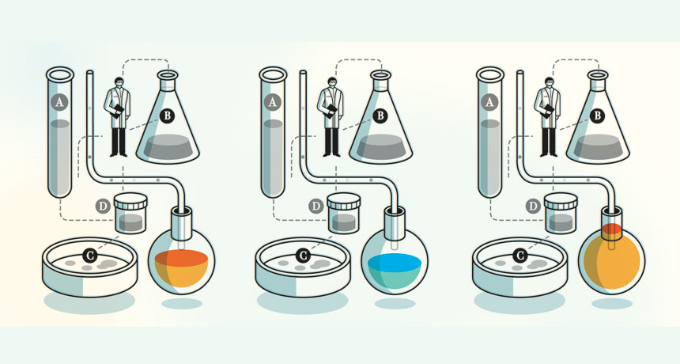
Experiments/Results

Slide 18
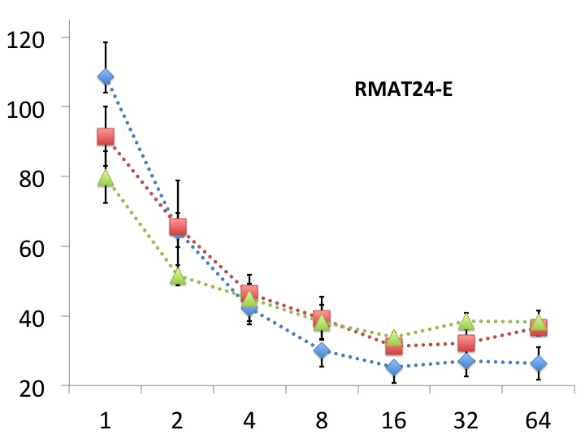
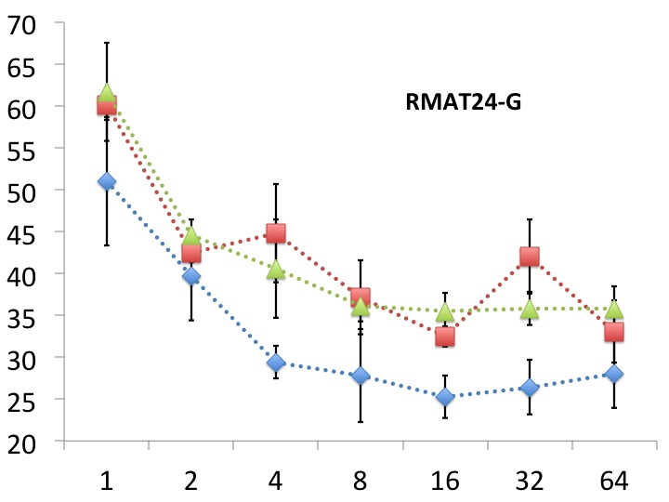
Updating MST
=100%
=100%
=75%
=50%
=75%
=50%

Slide 19
Comparison to recomputation-based approach for SSSP
New algorithm is up to 4X faster.
*36-core Intel Haswell system with
256 GB memory OpenMP implementation

Slide 20
Strong scaling (synthetic graphs) for SSSP
*36-core Intel Haswell system with
256 GB memory OpenMP implementation

Slide 21
Strong scaling (real-world graphs) for SSSP
*36-core Intel Haswell system with 256 GB memory
OpenMP implementation

Slide 22
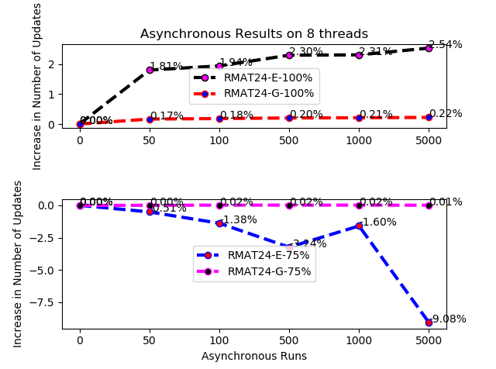
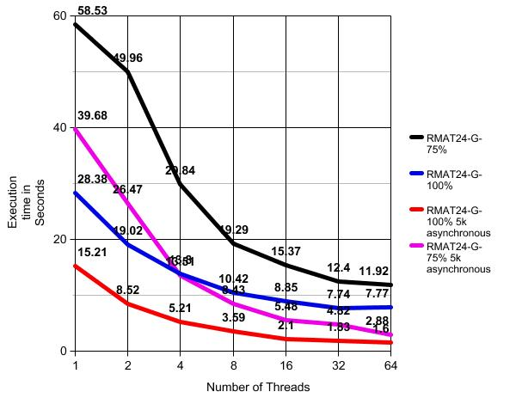
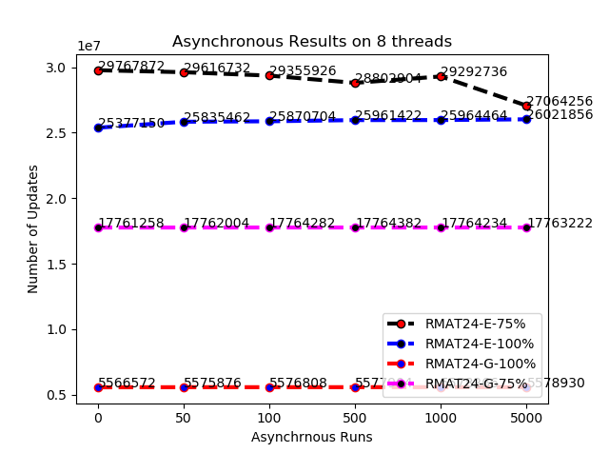
Asynchrony
Controlling the length of the path to be traversed before synchronization
In the case of updating SSSP, initially Level -1 where immediate neighbors are processed, and Level -2, only distance -2 neighbors are processed

Slide 23

ARCHITECTURE

Slide 24
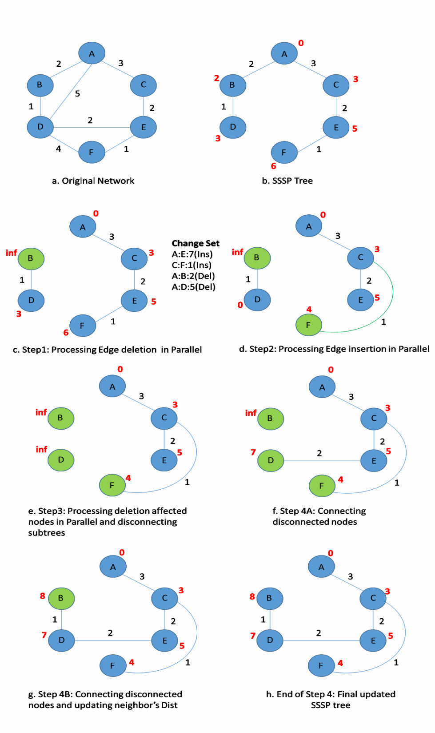
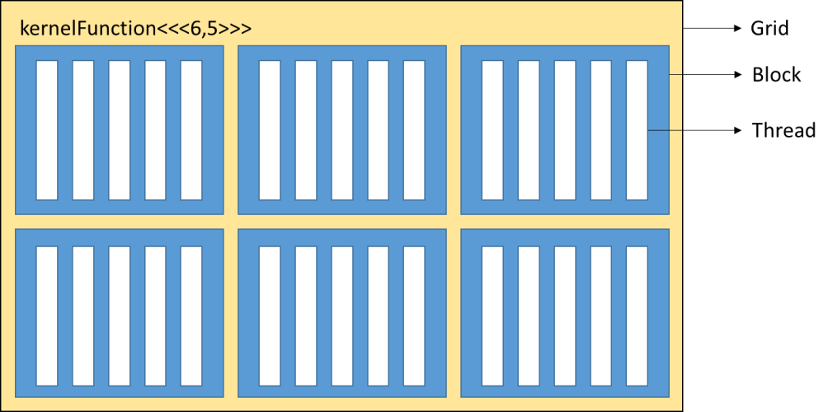
Single GPU SSSP update

Slide 25
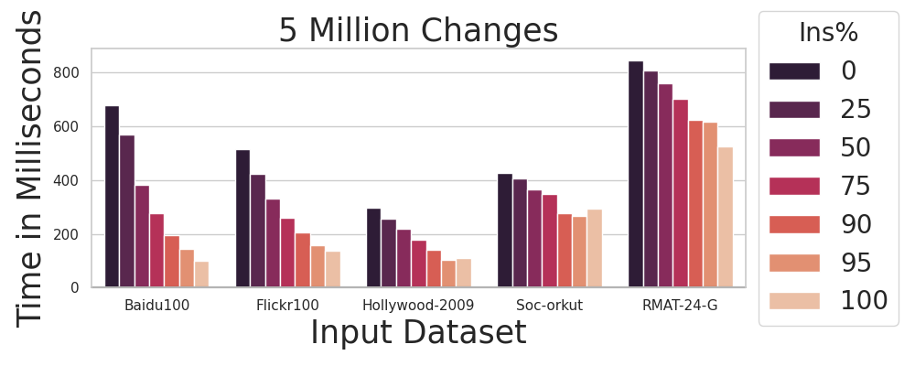
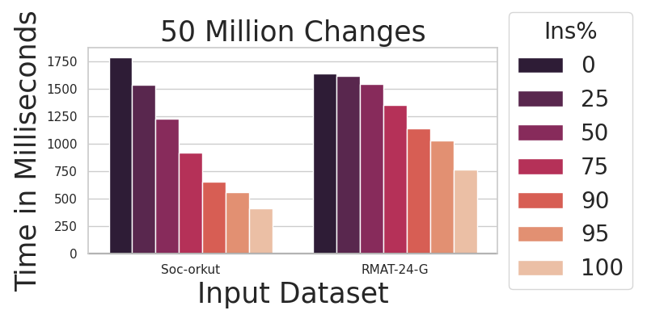
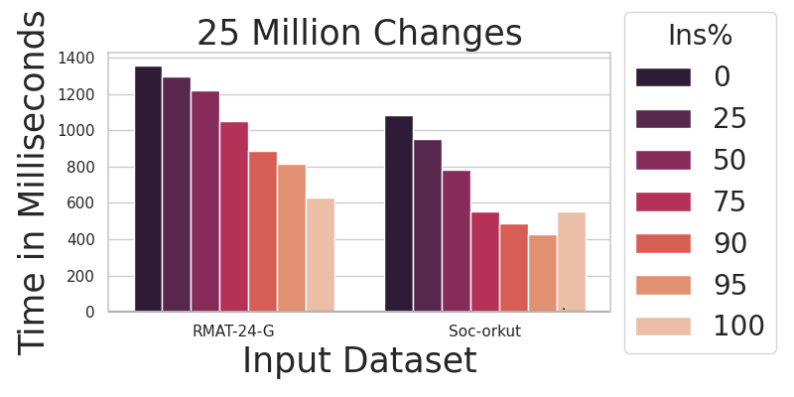
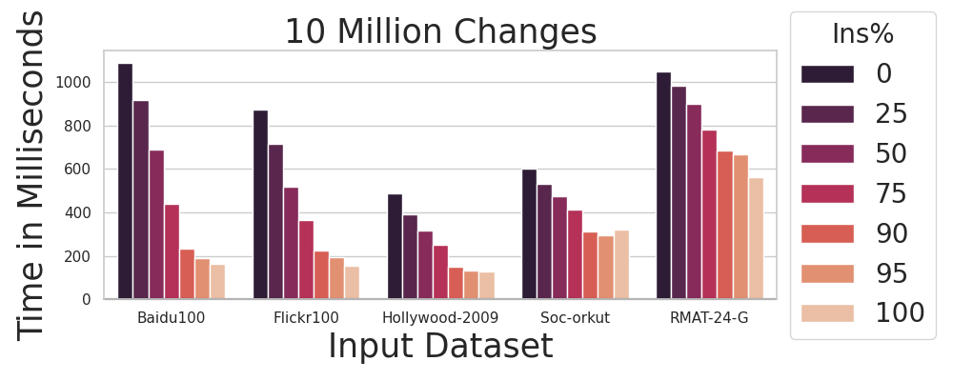
GPU Implementation

Slide 26
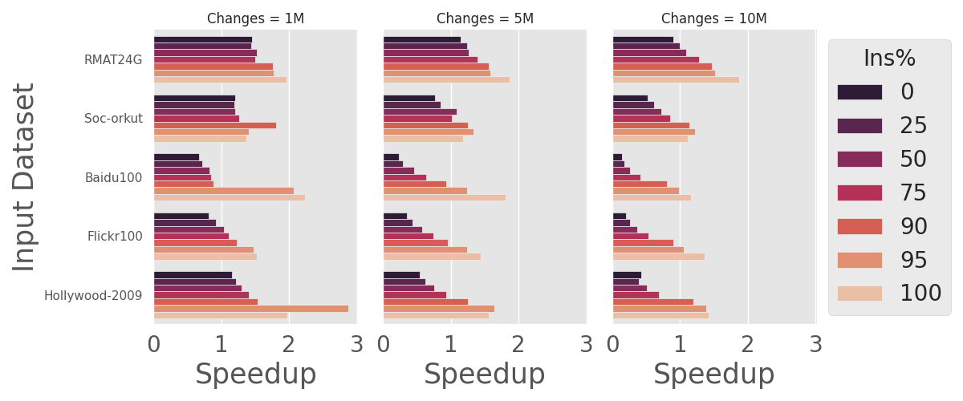
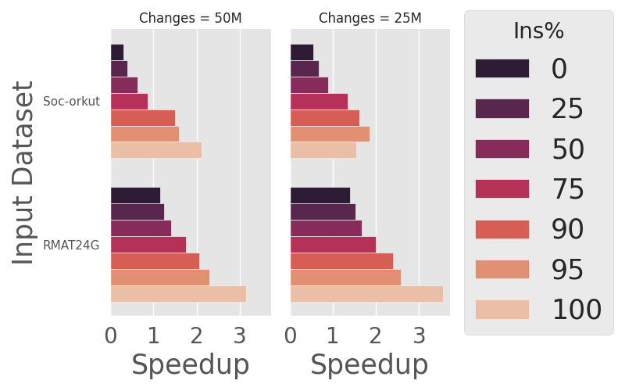
Speedup (Dynamic Update VS Recompute) Gunrock ** (GPU Implementation)

Slide 27
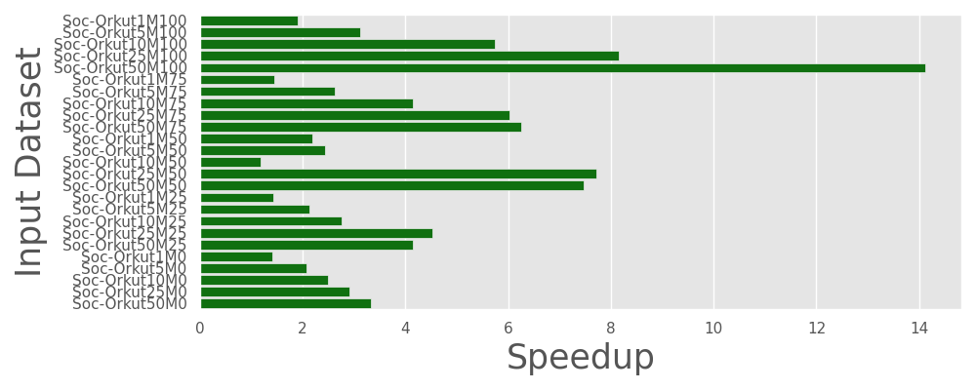
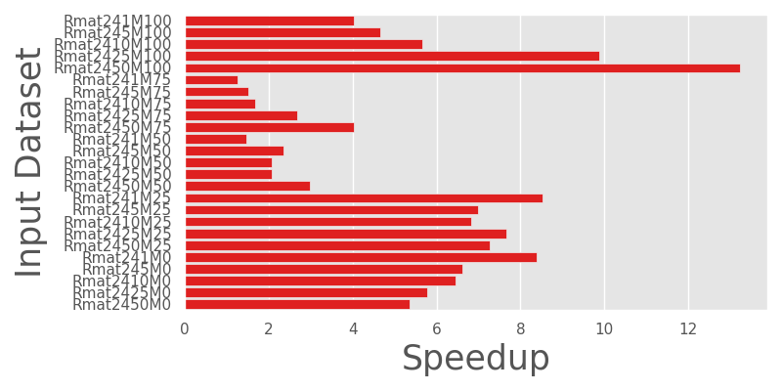
CPU VS GPU Speedup
GPU implementation performs better than shared memory implementation (CPU)

Slide 28
Strongly Connected Components
Two sets of key edges required
Minimum set of edges that create each component (KE 1)
Deletion of these edges breaks SCCs
Set of edges that connect SCC (KE 2)
Insertion across SCC combine SCCs
1
13
12
2
5
14
3
4
10
11
6
9
7
8

Slide 29
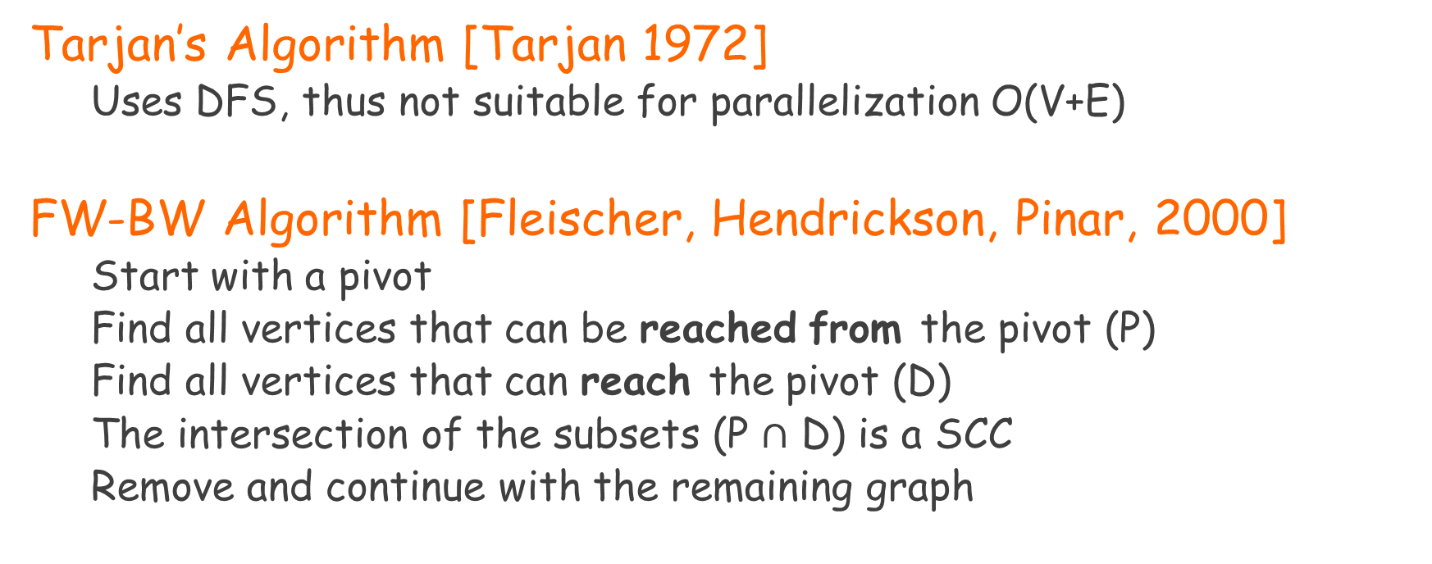
Algorithms for Detecting SCC
Tarjan’s Algorithm [Tarjan 1972]
Uses DFS, thus not suitable for parallelization O(V+E)
FW-BW Algorithm [Fleischer, Hendrickson, Pinar, 2000]
Start with a pivot
Find all vertices that can be reached from the pivot (P)
Find all vertices that can reach the pivot (D)
The intersection of the subsets (P $∩$ D) is a SCC
Remove and continue with the remaining graph

Slide 30
SCC-Deletion
Mark the end point of the deleted edge
Remove each node that is source/ sink (Trimming)
Run coloring algorithm using the endpoints as pivots until
(i) The endpoints have the same color (SCC unbroken)
(ii) Components for all vertices in the SCC are found
1
13
12
2
5
14
3
4
10
11
6
9
7
8
Component (1,2,3,4,5) is unbroken
Component (6,7,8,9) broken to (6,7,9) and (8)

Slide 31
SCC-Insertion
Use the sources as pivots and run the coloring algorithm
If a vertex is colored all the vertices in the component are colored
Coloring within component is O(1)
Potentially need to traverse only part of the graph
1
13
12
2
5
14
3
4
10
11
6
9
1
7
8
7
11
Reduces to a much smaller graph
Adding 3-7 combines {1,2,3,4,5,6,7,9)
Adding (1-10) does not change anything
8

Slide 32
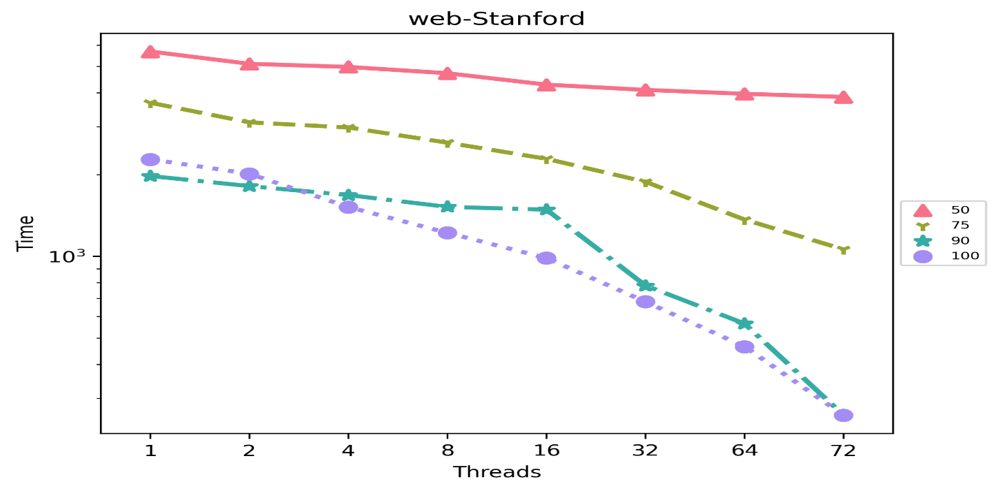
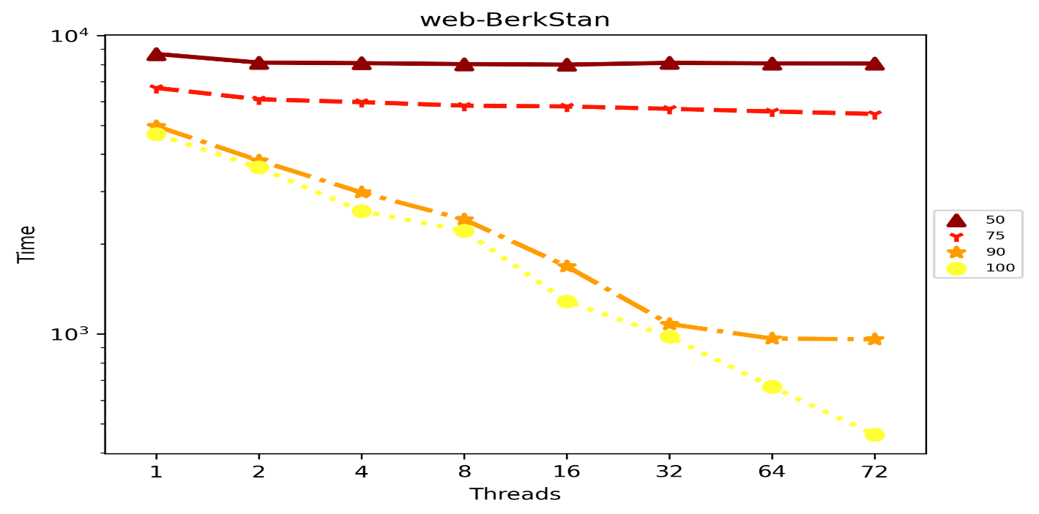
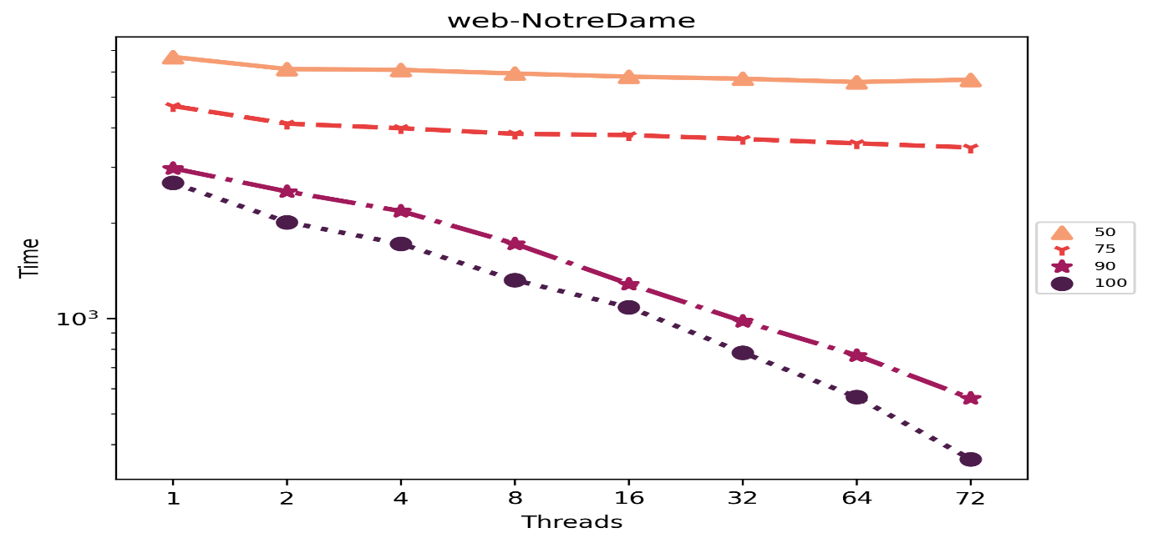
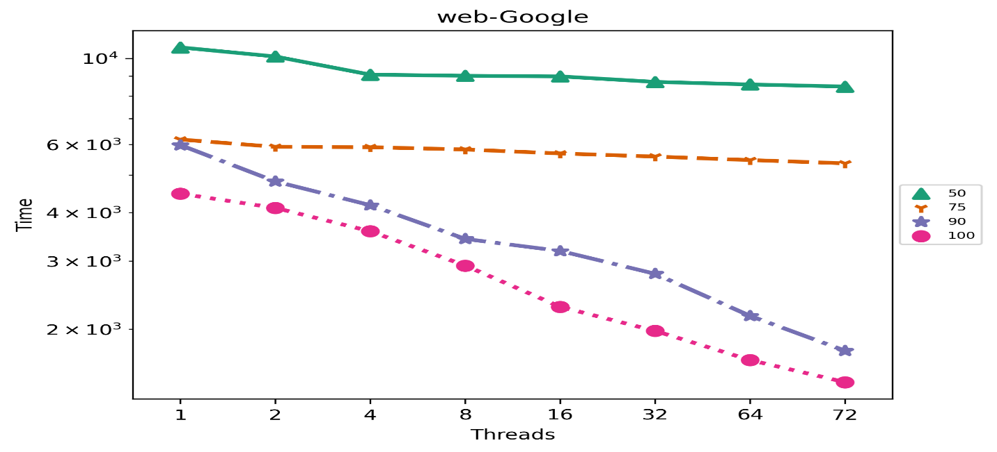
SCC Scalability
SCC implementation flattens around 16-32 threads for edge insertion <90 % (10M changed edges)

Slide 33
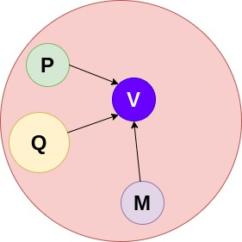
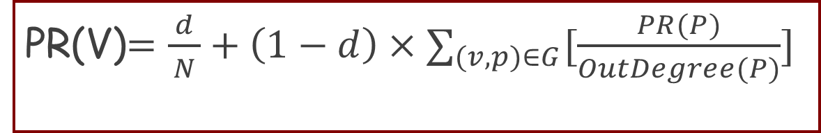
Page Rank
PR(V)$=\frac{ d }{N}+\left(1−d\right)×∑_{(v,p)∈G}[\frac{PR(P)}{OutDegree(P)}]$
PR(v)=internal deg of v
d=probability that any random walk from anywhere can reach the vertex
OutDegree (v)=Outdegree
N=Total number of nodes
PR(V)$=\frac{ d }{N}+\left(1−d\right)×$ [$\frac{PR\left(P\right)}{OutDegree(P)}+\frac{PR\left(Q\right)}{OutDegree(Q)}$+ $\frac{PR\left(M\right)}{OutDegree(M)}$]
*Assumption:- Input is a directed graph
Notes:
Mention that more details are in the paper

Slide 34
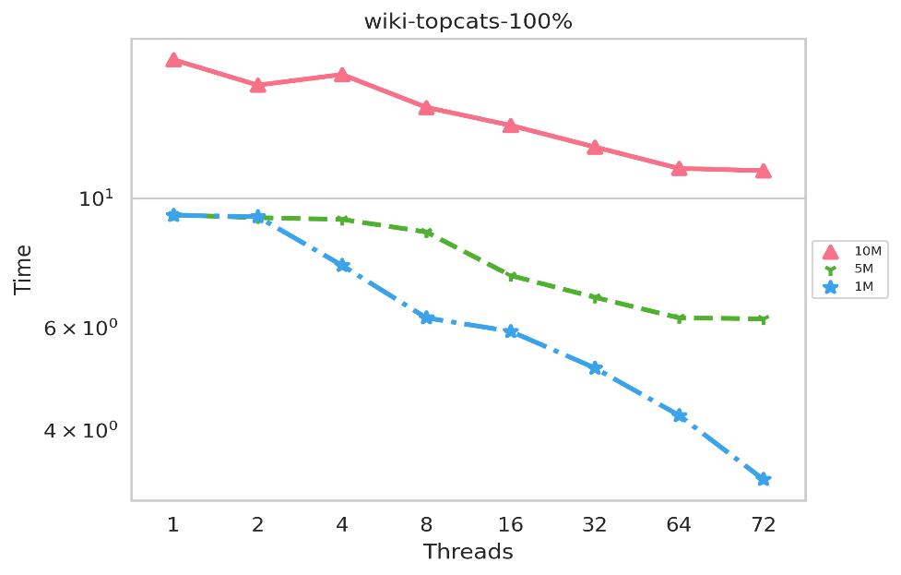
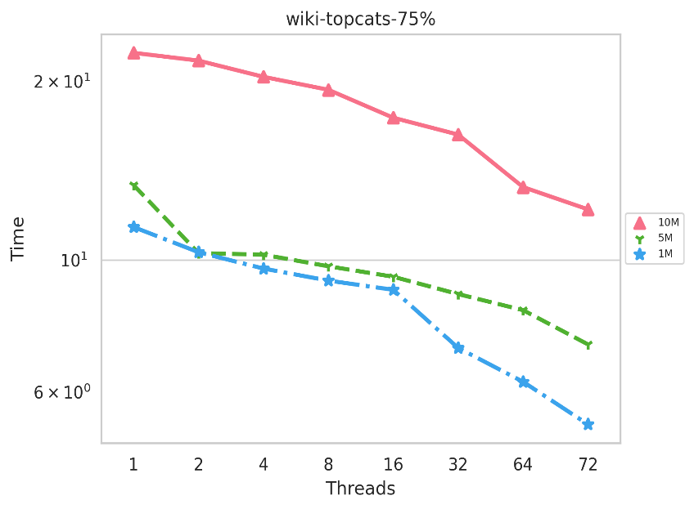
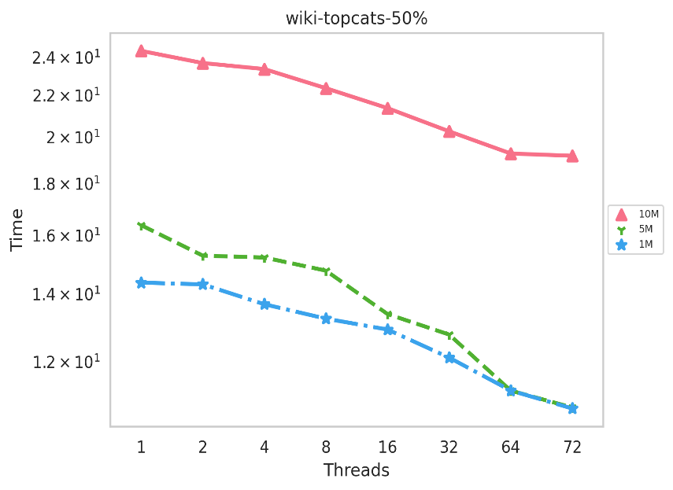
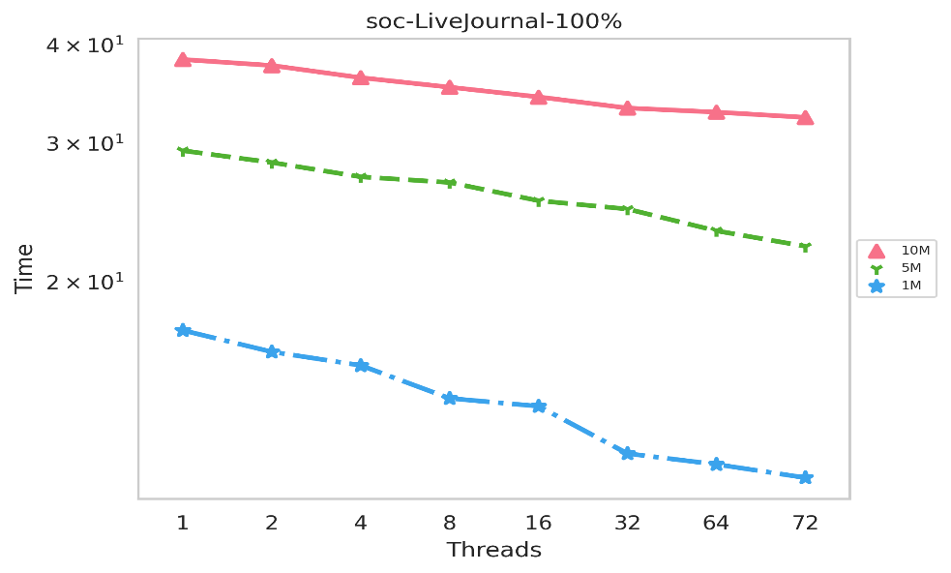
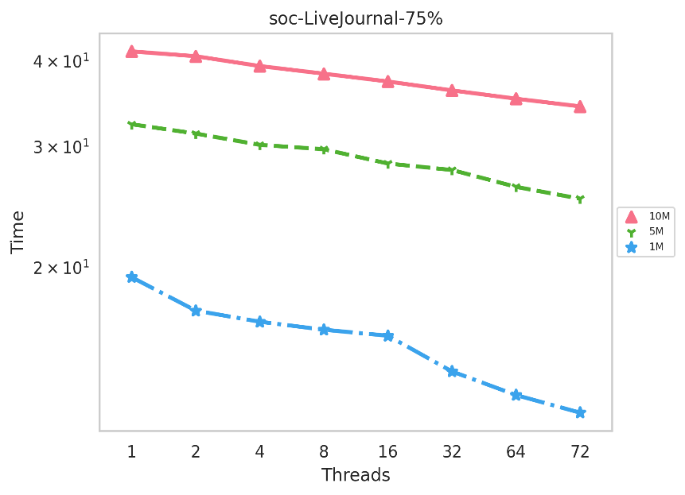
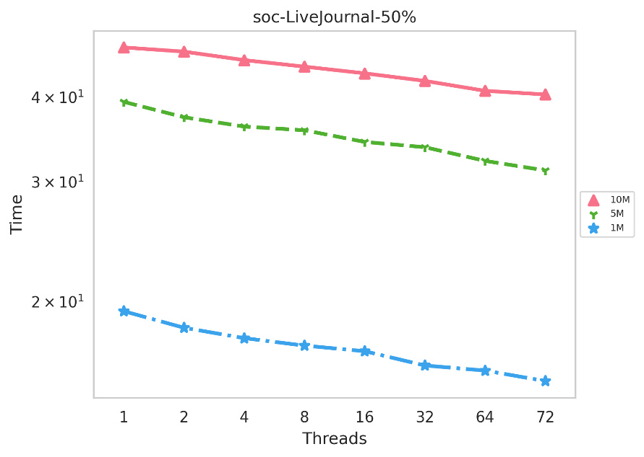
Page Rank Scalability
PR implementation flattens around 16 threads for all cases (Baseline condition)

Slide 35
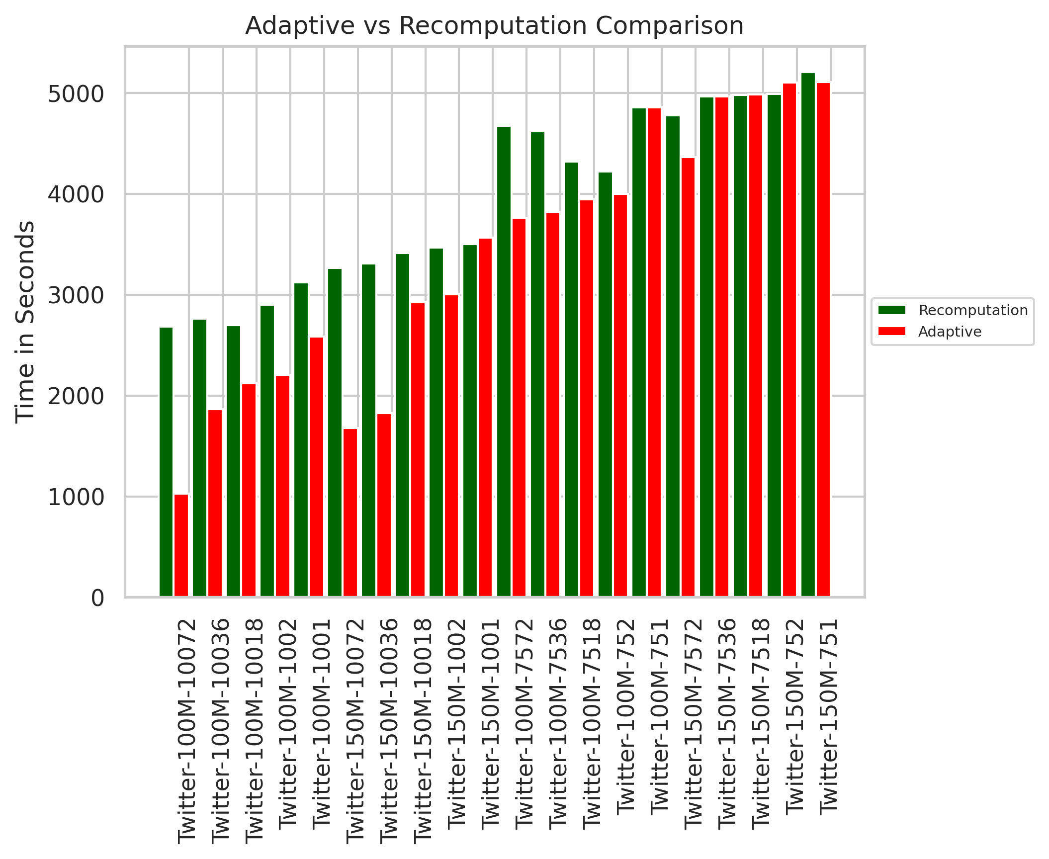
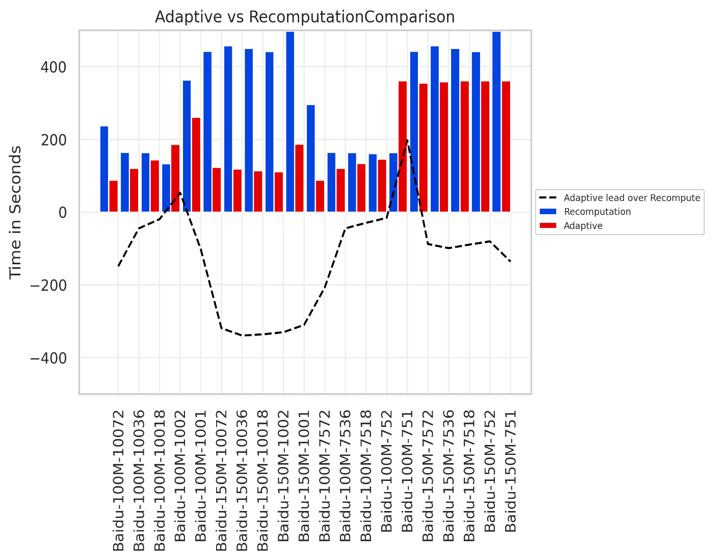
Adaptive vs Recomputation (Batches:-15, Recompute:-80%)
Adaptive Implementation performs well in most cases except for lower thread counts

Slide 36
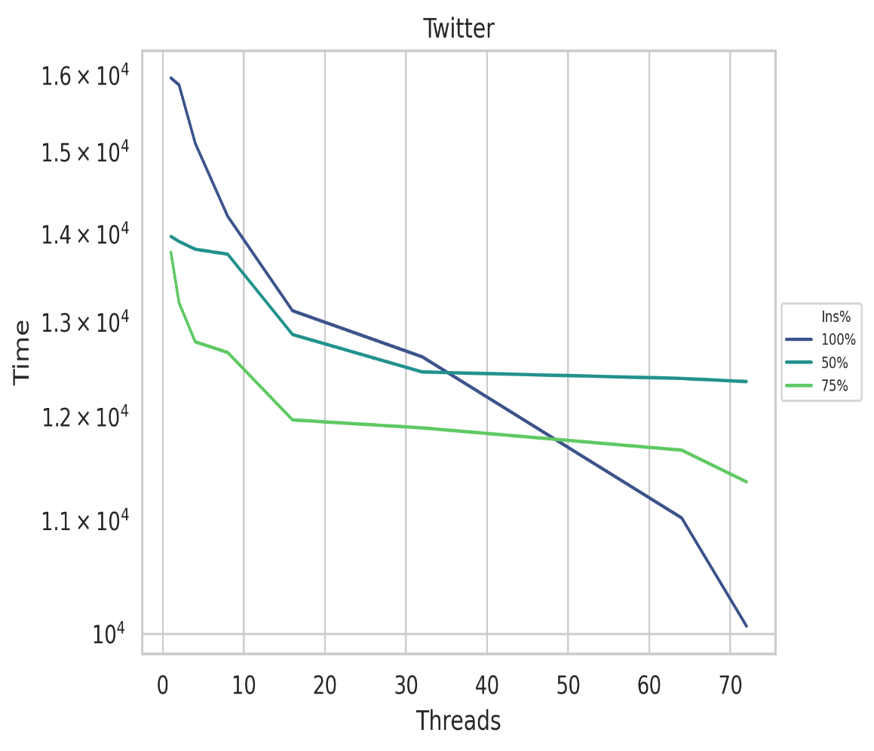
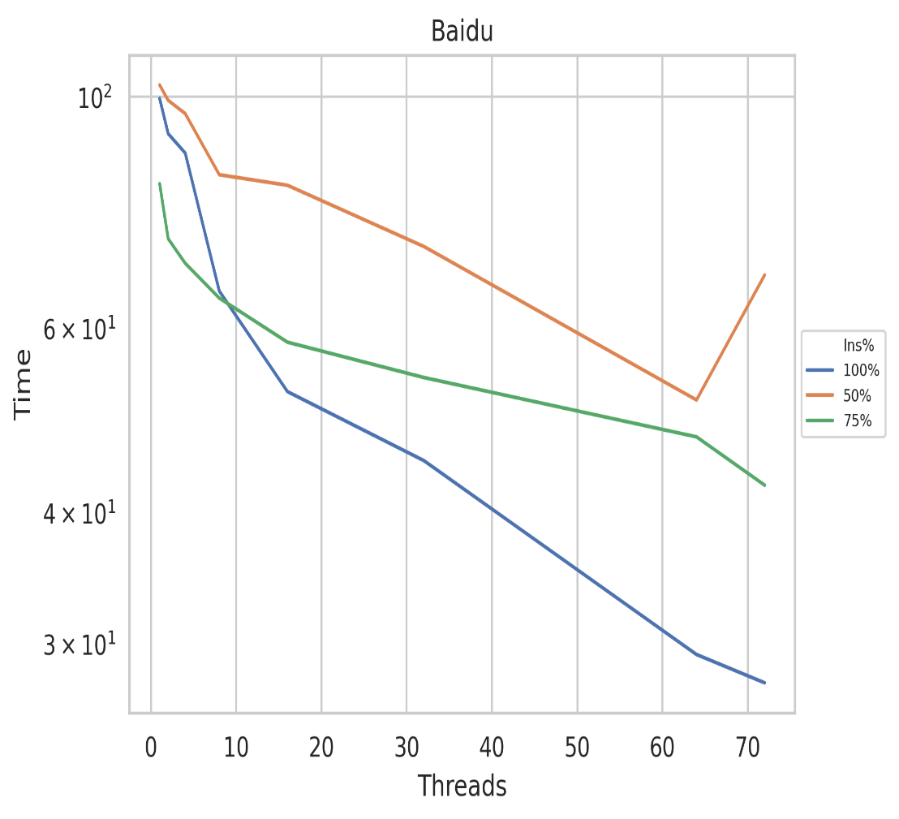
Adaptive Scalability (Number of Batches:-30)
Recompute %
Ins % | Twitter | Baidu
100 | 70 % | 60 %
75 | 80 % | 70 %
50 | 90 % | 90 %
Adaptive implementation scales well (especially for edge ins % < 50)

Slide 37
Correctness proof
SSSP :-
Lemma:- Tree obtained by the proposed approach will be a valid SSSP tree for the updated Graph G. (Page Number :-60-61 )
MST :-
Lemma:- After updating MST, sum of edge weights of the updated graph is equal to the sum of the weights of the active key edges in the rooted tree. (Page Number :-46-47)
Connected Components :-
Lemma:- After updating connected components, if there exists a path between two vertices u and v in updated graph, there also exist a path between those two vertices in the updated rooted tree. (Page Number:-45-46)
(Complete proof please check dissertation, all the mathematical proofs are done using principle of contradiction)

Slide 38
Observations about graph updates
Updates may only affect a subgraph and the complete graph need not be analyzed
Not all updates affect the property updates can be processed in parallel
Not all updates affect the same subgraph affected subgraphs can be processed in parallel
A Shared-Memory Algorithm for Updating Tree-based Properties of Large Dynamic Networks. S. Srinivasan, S. Pollard, S. Das, B. Norris, S. Bhowmick. IEEE Transactions on Big Data 2018
Single-Source Shortest Path Tree for Big Dynamic Graphs. S. Riazi, S. Srinivasan, S. Das, B. Norris, S. Bhowmick. IEEE International Conference on Big Data Workshop 2018
A Shared-Memory Parallel Algorithm for Updating Single-Source Shortest Paths in Large Dynamic Networks. S. Srinivasan, S. Riazi, S. Das, B. Norris, S. Bhowmick. IEEE HiPC 2018

Slide 39
Challenges
Dynamic updating should take less time than recomputing.
Complexity of sparsification > Complexity of computation (SCC)
Strongly connected component is used for detecting cycles in dataflow graphs
Complexity of selection > Complexity of computation (MST)
Job Shop Problem (for a set of jobs that have to be executed on a set of machines, find the sequence for each job such that total time is minimized)
Solved using TSP, Minimum Weighted Spanning Tree is a popular heuristic.
Complexity of update > Complexity of computation (SSSP)
Used for optimizing scheduling on weighted DAGs (flight schedule, railway routes)

Slide 40
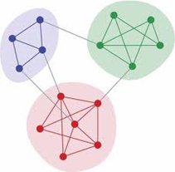
Community Detection
Communities are groups of vertices that are more tightly connected to each other than other vertices in the network
Numerous methods/metrics exist
Modularity (more connections than random)
Conductance (less connections between in a communities)
Random Walk (vertices most often visited are in a community)
Soccer
Theatre
Internal neighbors should be tightly connected
=> High clustering coefficient

Slide 41
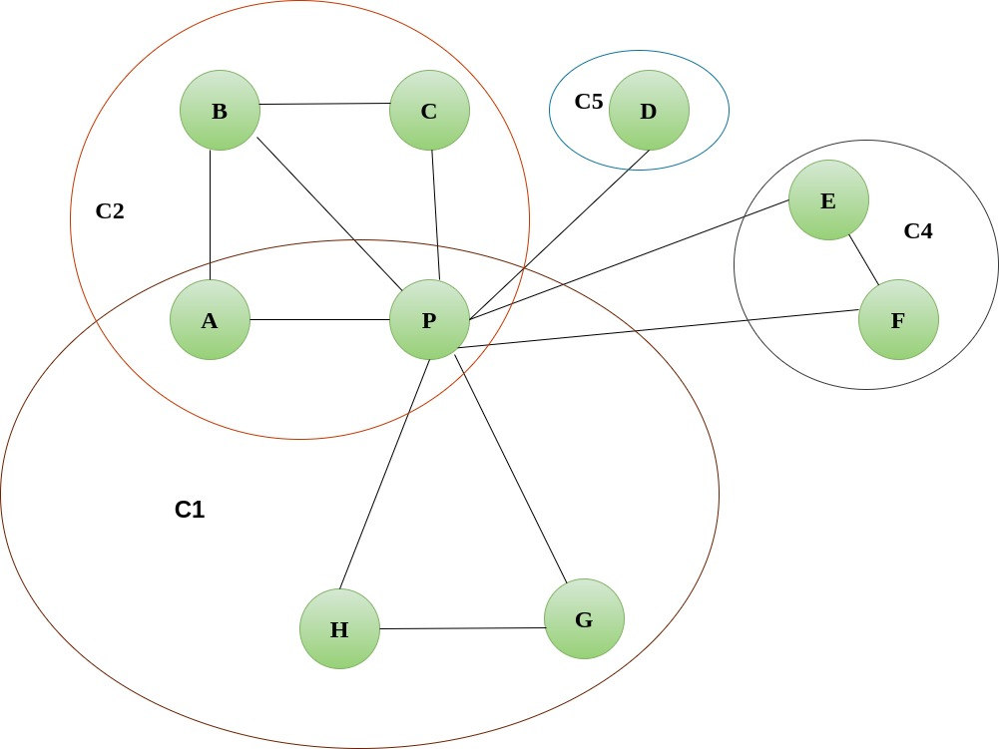
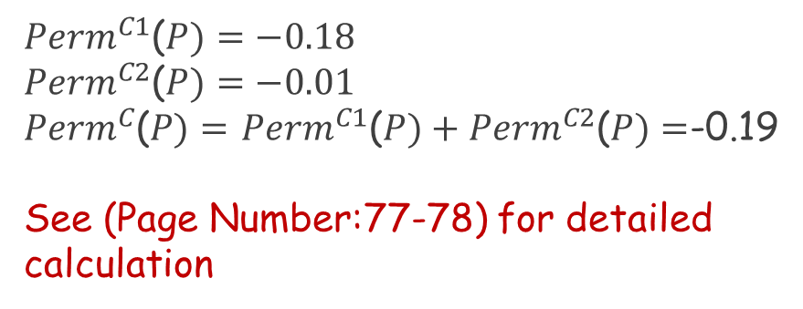
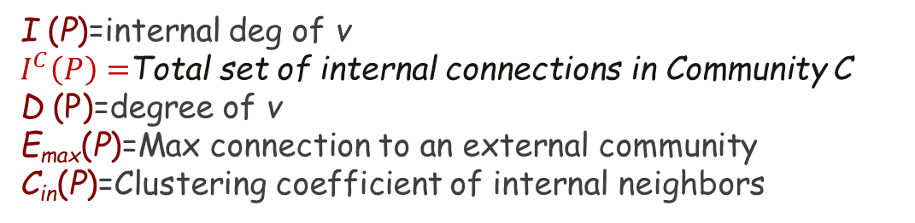
Permanence
$${Perm}^{c}\left(P\right)= \left\lceil \frac{I^{C}(P)}{E_{max}}×\frac{1}{D(P)}\right\rceil −\left[1−C_{in}\left(P\right)\right]×\frac{I^{C }\left(P\right)}{I(P)}$$
I (P)=internal deg of v
$I^{C}\left(P\right)=$Total set of internal connections in Community C
D (P)=degree of v
E_{max}(P)=Max connection to an external community
C_{in}(P)=Clustering coefficient of internal neighbors
${Perm}^{C1}$($P)=−0.18$
${Perm}^{C2}$($P)=−0.01$
${Perm}^{C}$($P)=$ ${Perm}^{C1}$($P)+{Perm}^{C2}\text{(}P)=$-0.19
See (Page Number:77-78) for detailed calculation
Perm(P)=-0.19
D(P)=8

Slide 42
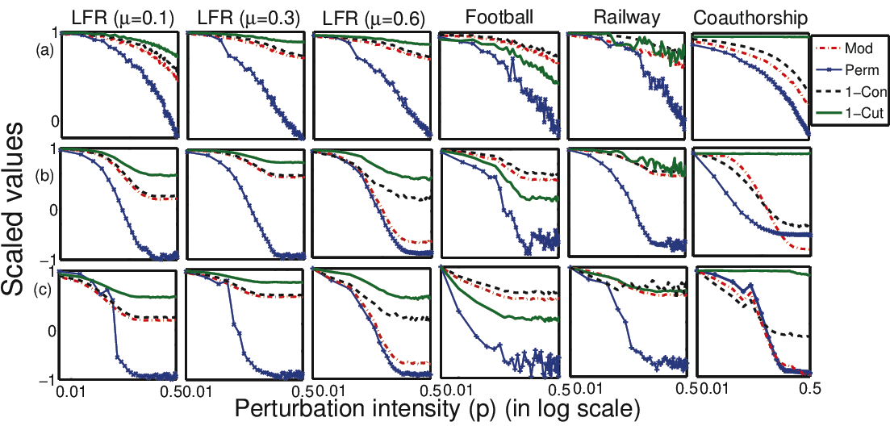
Permanence Properties
Vertex-based
Uniform Scale
Independent of network size
Handles Resolution Limit
Is Sensitive to Changes
Permanence is robust to small changes and sensitive to large changes
Permanence
Each row represents a different methods of swapping vertices across two communities
Notes:
Say that you will illustrate the last two points by empirical results in the following slides

Slide 43
Maximizing Permanence
Seeding:
Assign vertex and its neighbors to one cluster
Update:
For each vertex, try to check the permanence score by moving to its neighboring community, if there is an overall gain then assign an additional community to v. For example Vertex C belongs to C1 and C2, it has a neighboring community C3 because of edge connection with B. Now moving C to C3 update phase checks if permanence value increases
Original Network
Seeding
A
A
B
C
B
C
F
F
D
E
D
E
Update
A
C1
B
C
C2
Assumption:- Network is undirected and unweighted
C3
F
D
E

Slide 44
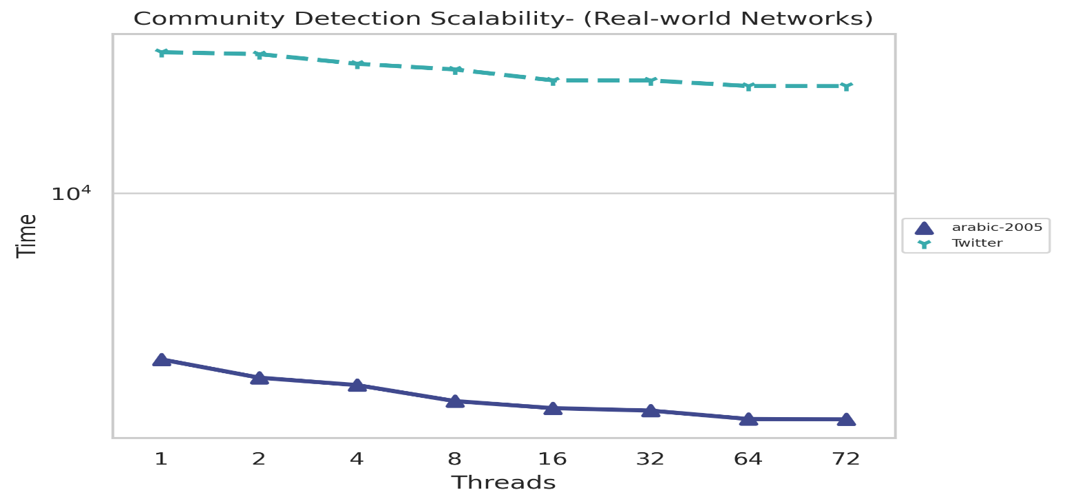
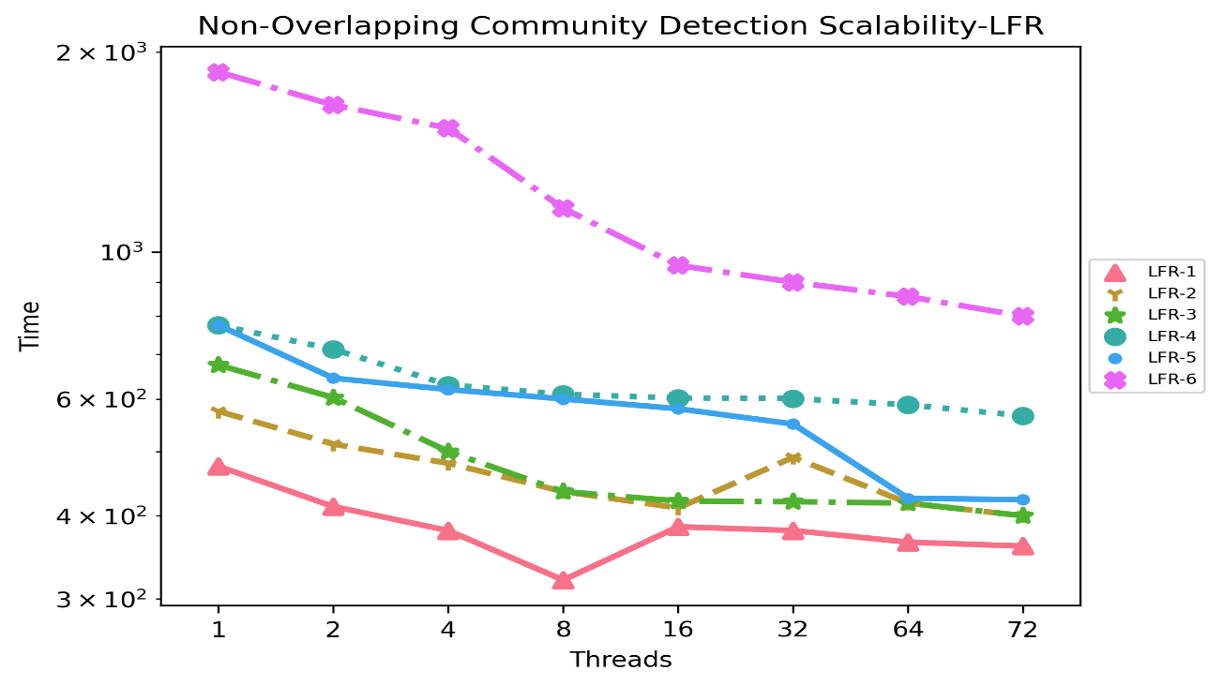
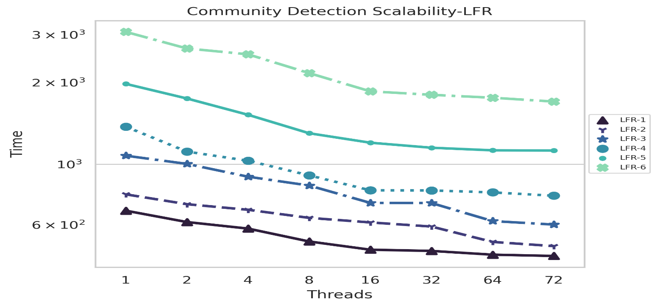
Scalability
Implementation is scalable up to 32 threads (Baseline condition)
For com-DBLP (real-world) implementation is scalable up to 32 threads
Overlapping Communities, implementation flattens out around 12-16 threads (Baseline condition)

Slide 45
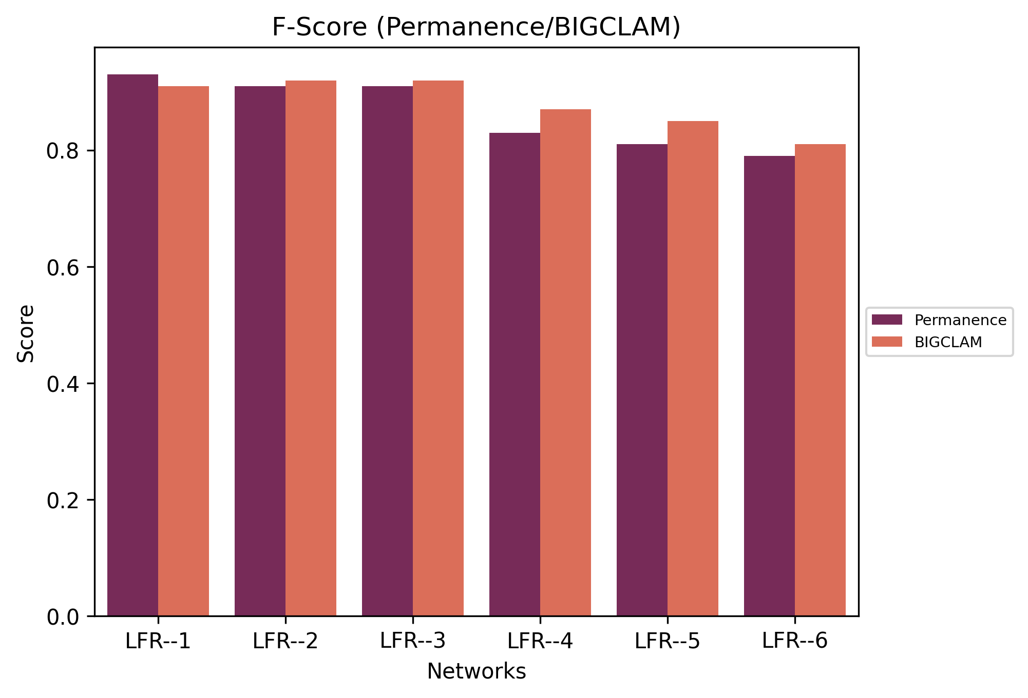

Community Quality
F-Score$=\frac{2×(precision×recall)}{(Precision+recall)}$
**F-Score (Macro-averaged per each classification)
Higher the F-Score indicates good community structure (when compared to its ground truth)

Slide 46

Dissertation Contributions
A new three-step parallel algorithm for updating the SSSP, MST, PR & Connected Components
optimizations to improve scalability
optimizations to reduce redundant/wasteful computation
Correctness proof
Empirical evaluation to demonstrate speedup over recomputing SSSP & MST from scratch

Slide 47
Research Questions
How to improve scalability of updating
Hybrid: move to recomputing once the edges that affect the property are known
Asynchrony: increase length of asynchrony during updating
Hot Spots: identify subgraphs that will be most affected by change, store them separately
Scheduling Changes: if changes are known, can we schedule them for improved performance
How to measure scalability of updating
Time: fundamental measure, but affected more by type and amount of changes than size of graph
TEPS: traversed edges per second, but we are trying to reduce the number of edges traversed
Others: number of edges updated per change

Slide 48



Timeline
Brainstorming on how to analyze dynamic networks
Brainstorming on how to update MSTand SSSP.
PR, and Community Detection, GRACA Funding $5K
Solved SSSP, (SC16, Poster **) (Published@ HIPC 18)
August 2015
June 2016
Dec 2016
May 2017
March 2018
March 2019
Dec 2020
Solved Connected Components. Published @ IPDPS 2016 (GABB)
Solved MST, Presented in SIAM CS17, and IPDPS (Ph.D.forum) 2017. IEEE Transactions on Big data Journal (Accepted @ 06/2018)
SCC Implementation, GRACA Funding $5K
**SC 16 Student Poster (Semi Finalist Candidate )

Slide 49
Future Research -(Task 1, Shared Memory Implementation of Overlapping Communities)
Research problem :- Scalable implementation of algorithm to detect overlapping communities and measure the quality
Proposal:- Optimize shared memory implementation of GenPerm and use real-world networks for comparing quality of the community

Slide 50

Future Research (Task 2, Extending to GPUs (Single and Multi))
Research problem :- Shared memory implementations of updating SSSP, & MST on dynamic networks show limited scalability as thread count increases. GPUs can be a good candidate for updating the network properties to achieve better scalability
Proposal :-Implement GPU version of updating MST on dynamic networks, and extend update single GPU SSSP to Multi GPUs

Slide 51
Conclusions
New shared-memory algorithm for updating SSSP, MST, Page Rank, and SCC in dynamic networks
New shared-memory algorithm for detecting Non- Overlapping/Overlapping Communities
Plan to extend the general approach to Multi GPUs and distributed-memory implementations such as MPI
A Shared-Memory Algorithm for Updating Tree-based Properties of Large Dynamic Networks. S. Srinivasan, S. Pollard, S. Das, B. Norris, S. Bhowmick. IEEE Transactions on Big Data 2018
Single-Source Shortest Path Tree for Big Dynamic Graphs. S. Riazi, S. Srinivasan, S. Das, B. Norris, S. Bhowmick. IEEE International Conference on Big Data Workshop 2018
A Shared-Memory Parallel Algorithm for Updating Single-Source Shortest Paths in Large Dynamic Networks. S. Srinivasan, S. Riazi, S. Das, B. Norris, S. Bhowmick. IEEE HiPC 2018
Application of Graph Sparsification in Developing Parallel Algorithms for Updating Dynamic Networks. S. Srinivasan, S. Das, S. Bhowmick, Graph Algorithms Building Blocks (GABB’2016)
Permanence and community structure in complex networks T.Chakraborty, S.Srinivasan, N.Ganguly, A.Mukherjee, and S.Bhowmick, ACM Transactions on Knowledge Discovery from Data (TKDD)

Slide 52

Acknowledgments & Collaborators
Dr. Boyana Norris
University of Oregon
Dr. Mahantesh Halappanavar
PNNL
Dr. Sajal Das
Missouri S&T
Dr. Kate Cooper
University of Nebraska, Omaha
GRACA (2019,2020) **Mentor :- Dr. Kate Cooper

Slide 53

Thank you!
Questions?
Corresponding author: Sriram Srinivasan, sriramsrinivas@unomaha.edu
github.com/SriramSrinivas/SriramDissertation

